Slide 1
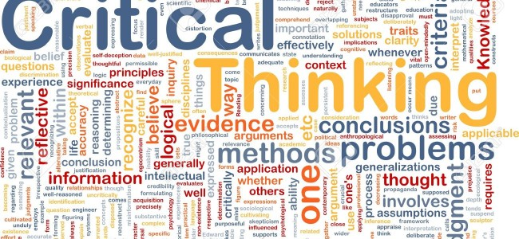
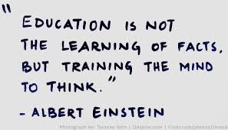
Critical Thinking

Slide 2
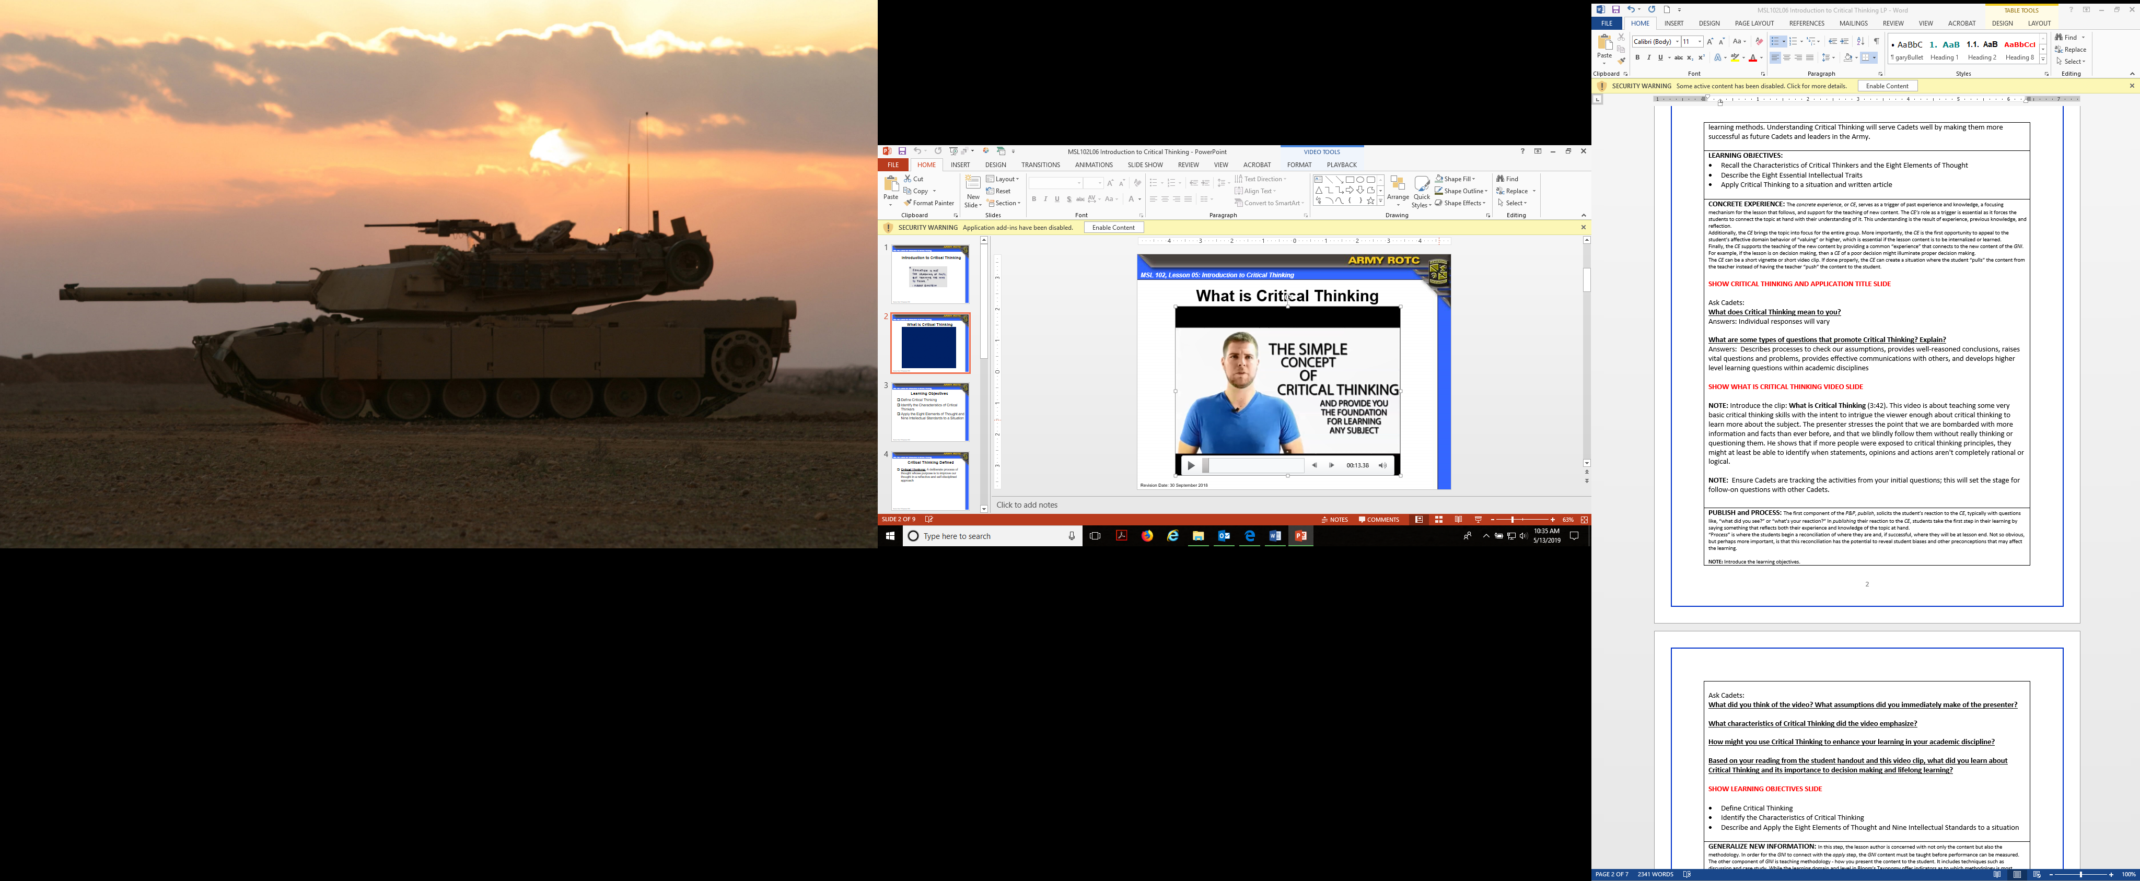
Concept of Critical Thinking
Concept of Critical Thinking

Slide 3
Learning Objectives
Define Critical Thinking
Identify the Characteristics of Critical Thinking and Eight Elements of Thought
Explain the Nine Intellectual Standards and Eight Essential Intellectual Traits
Apply Critical Thinking to a situation or written article

Slide 4
Critical Thinking Defined
Critical Thinking: A deliberate process of thought whose purpose is to improve our thought in a reflective and self-disciplined approach

Slide 5
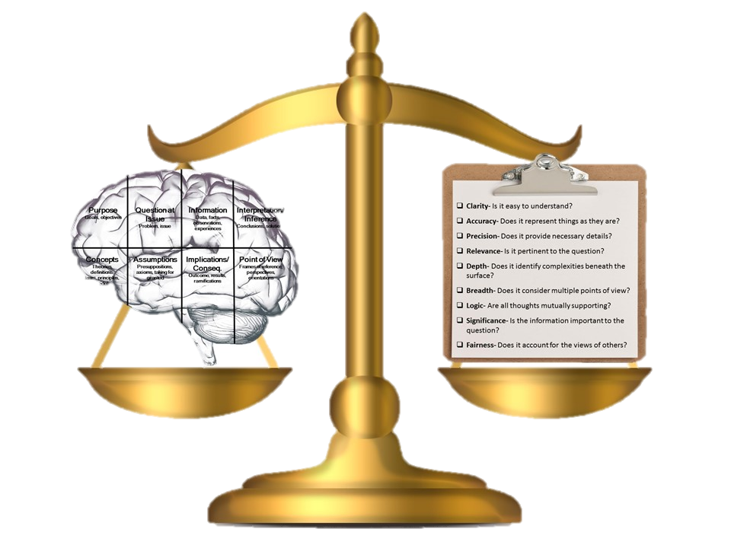
Characteristics of Critical Thinkers
Critical Thought:
Is clear to the purpose at hand
Questions information, conclusions, and points of view
Strives to be clear, accurate, and relevant (expressed in writing/speech)
Goes beneath the surface
Seeks to be logical and fair
Checks assumptions
Applied in all subjects and throughout life
=

Slide 6
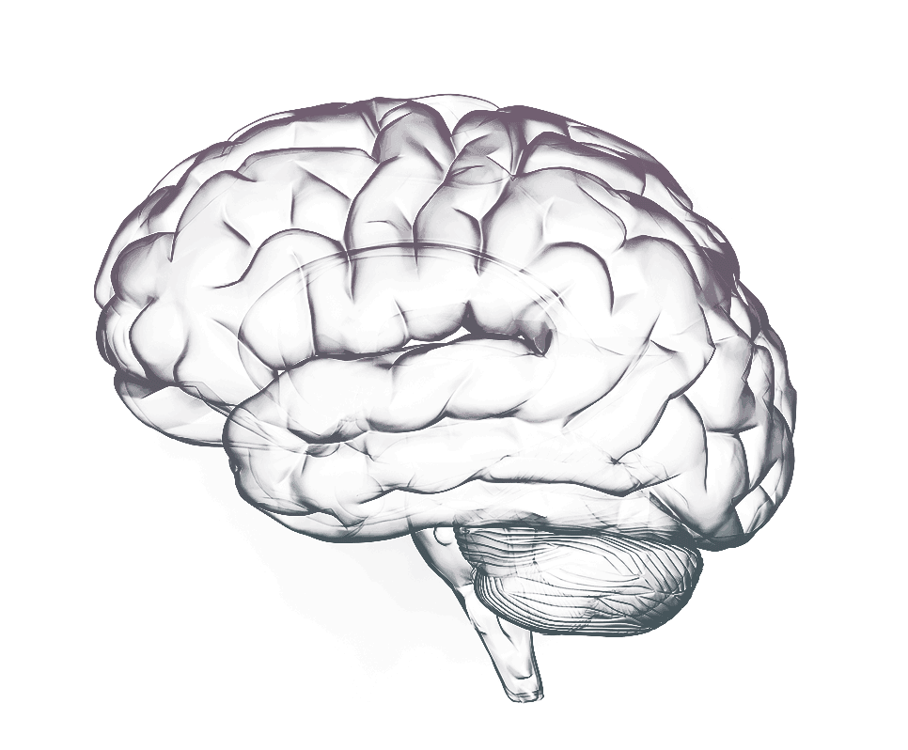
Eight Elements of Thought
Question at Issue
Problem, issue
Information
Data, facts, observations, experiences
Purpose
Goals, objectives
Interpretation/
Inference
Conclusions, solutions
Concepts
Theories, definitions, laws, principles, models
Assumptions
Presuppositions, axioms, taking for granted
Implications/
Conseq.
Outcome, results, ramifications
Point of View
Frames of reference, perspectives, orientations

Slide 7

Nine Intellectual Standards
Clarity- Is it easy to understand?
Accuracy- Does it represent things as they are?
Precision- Does it provide necessary details?
Relevance- Is it pertinent to the question?
Depth- Does it identify complexities beneath the surface?
Breadth- Does it consider multiple points of view?
Logic- Are all thoughts mutually supporting?
Significance- Is the information important to the question?
Fairness- Does it account for the views of others?

Slide 8
Eight Essential Intellectual Traits
Fair-mindedness
Intellectual Humility
Intellectual Courage
Intellectual Empathy
Intellectual Integrity
Intellectual Perseverance
Confidence in Reason
Intellectual Autonomy

Slide 9
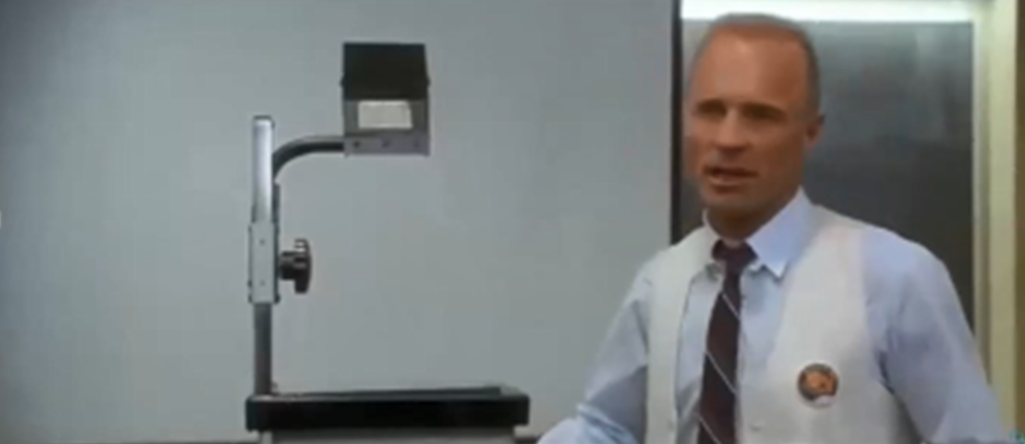
Apollo 13 “New Mission”
Apollo 13 “New Mission”

Slide 10
Assessment
So What Journal
Instructions:
Develop a So What? Journal that identifies what you believe the theme of the lesson is and why it is important
This assessment will be at least 500 words
The assessment will be turned in at the beginning of the next class

Slide 11
Closing
Review Learning Objectives:
Define Critical Thinking
Identify the Characteristics of Critical Thinking and Eight Elements of Thought
Explain the Nine Intellectual Standards and Eight Essential Intellectual Traits
Apply Critical Thinking to a situation or written article
Questions
Next Lesson:
CADET POST-CLASS ASSIGNMENT
Complete So What? Journal Assignment (Lesson Assessment); turn in next class

